Slide 1
Arguments

Slide 2
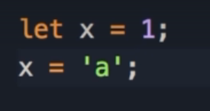
Dynamic Language
In a previous lesson, you learnt that JavaScript is a dynamic language.
This means we can declare a variable, set it to a number, then change its type and set it to a string.
This is all perfectly valid from the perspective of the JavaScript engine.
This is one of the characteristics of a dynamic language.
We have the same concept in the arguments of a function
Notes:
Earlier in the course, you learned that JavaScript is a dynamic language, so we can declare a variable, set it to a number, and then change it's type and set it to a string, and that's perfectly fine from the perspective of a JavaScript engine.
This is one of the characteristics of a dynamic language.
But we have the same concept in the arguments of a function.

Slide 3
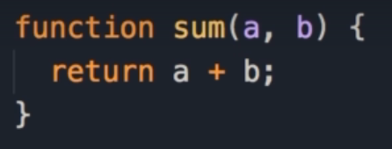


Parameters & arguements
Here we define a function called sum, which has 2 parameters: a & b.
When we call this function, we return the sum of a & b.
Here we do a console.log() and call the sum function, and pass 1 & 2 as the arguments.
In the console, we can see the result: 3.
Notes:
So I'm going to define a function here call it sum, that has two parameters, a and b.
And here we simply return the sum of a and b.
Now, let's do a console.log, and call the sum function, pass 1 and 2.
Save the changes, so we get 3.

Slide 4
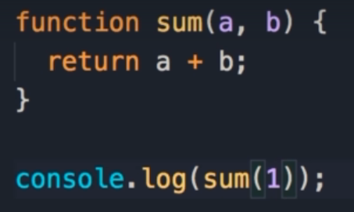

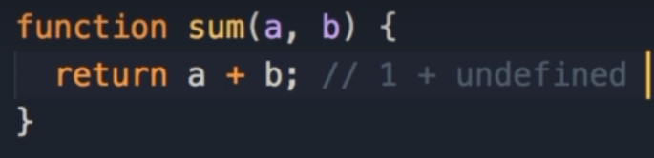
Excluding an argument
In JavaScript, it doesn't matter that our sum function has 2 parameters, we can pass only 1 argument.
In this case we get NaN, which stands for Not a Number.
This is because a is 1, and b by default is undefined.
When we try to add 1 & undefined, the result is NaN, as this is not a valid arithmetic operation
Notes:
But in JavaScript, it doesn't matter that this function has 2 parameters, we can pass only 1 argument.
So in this case we get not a number.
Because here a is 1 and b by default is undefined.
So when we have 1 plus undefined, the result is not a number, this is not a valid arithmetic operation.

Slide 5
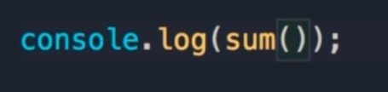
No arguments
The same happens when we don’t pass any arguments.
We do not get an error, we get NaN as a result
Notes:
The same happens if we don't pass any arguments.
So we don't get an error, we get not a number as a result.

Slide 6
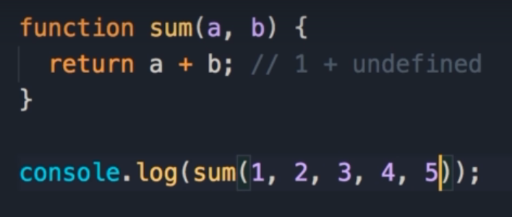

Additional Arguments
By the same token, we can pass additional arguments.
In this case we pass 5 arguments.
This is perfectly valid JavaScript code.
When we log this, we still get 3, because only the first 2 arguments are used.
Notes:
By the same token, we can pass additional arguments.
So in this case we can pass let's say 5 arguments.
And that's perfectly valid JavaScript code.
So when you save this, we still get 3, because only the first 2 arguments are used.

Slide 7
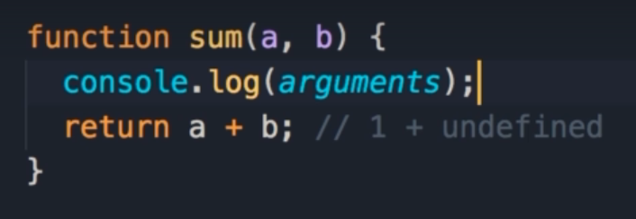
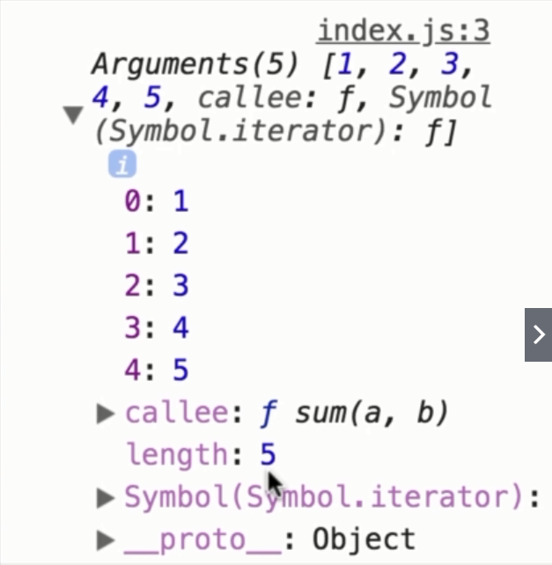
Arguments keyword
What if you want to have a varying number of parameters in a function, or you want to have the flexibility to pass as many arguments as we want, and get their sum?
Every function in JavaScript has a special object called arguments and when we log it to the console, we can see that it kind of looks like an array, but it's not an array, it's an object.
Notes:
But what if you want to have a varying number of parameters in a function?
What if you want to have the flexibility to pass as many arguments as we want, and get their sum.
Well, every function in JavaScript has a special object called arguments.
Let's log this on the console, console.log so this is the arguments object, you can see that it kind of looks like an array, but it's not an array, it's an object.

Slide 8
The keys we have in this object are indexes of the arguments passed to this function.
The first argument is 1, the second argument is 2, etc.
We have a length property that returns the number of arguments that are passed.
We also have this other property, callee, which returns the currently executed function, so we have a reference to our sum function.
This is the arguments object.
Notes:
But the keys we have in this object are indexes of the arguments passed to this function.
So, the first argument is 1, the second argument is 2, and so on.
Here we have a length property that returns the number of arguments that are passed, we have this other property, callee which returns the currently executed function, so you see we have a reference to our sum function.
So this is the arguments object.

Slide 9
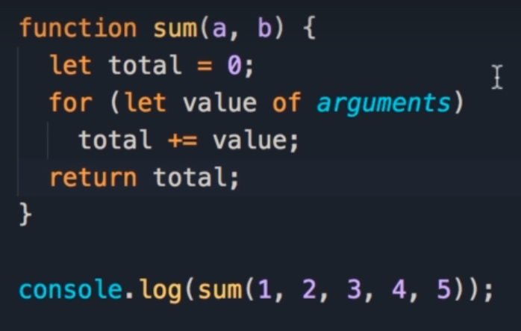
Using Arguments
Now we want to have a function with a varying number of parameters to work with all the arguments that are passed to this function.
Here we changed this function to return the sum of all its arguments with a simple algorithm.
First we declare a variable called total.
Then we start by using the for-of loop to iterate over the arguments object, and call each argument, value.
Earlier we learnt that we can use the for of loop, on arrays, but technically this loop can be used on any object that has an iterator.
The objects that we create with the object literal syntax don't have an iterator, but this particular object has a symbol.iterator.
That means this object has an iterator so we can use the for-of loop.
Notes:
Now if you want to have a function with a varying number of parameters to work with all the arguments that are passed to this function.
So let's say we want to change this function to return the sum of all these arguments.
Here's a very simple algorithm.
So, we declare a variable called total, set it to 0, then we can use the for of loop.
So let value of arguments we can use this loop to iterate over this arguments object.
Now earlier, I told you that we can use the for of loop, on arrays, but technically this loop can be used on any object that has an iterator.
So the plain objects that we create with the object literal syntax, they don't have an iterator, but this particular object you can see, here we have symbol.iterator.
That means this object has an iterator so we can use the for loop.

Slide 10


Sum of Arguments
Next, for every argument, we will add that value to the total variable.
Finally we return the total.
First we can see the total returned: 15.
Now if we add another argument, it will add it in.
Here we get: 25
Notes:
To iterate this object.
Now for every argument we're going to get that and add it to our total variable.
And finally we will return total.
Now save the changes, we get 15, we can add another argument, and we get 25.

Slide 11
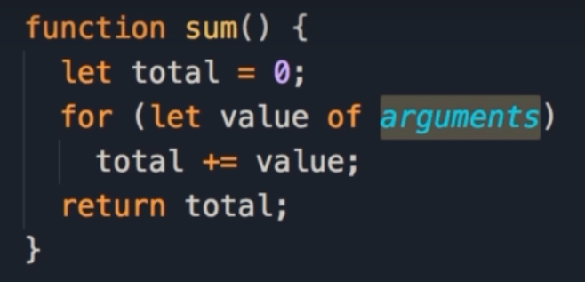
Cleaning the code
Now we can remove the parameters, because technically we are working with the arguments object to access the arguments passed in.
We are not referencing a or b anywhere within the body of the function.
Notes:
Now here's the interesting thing.
We can completely remove these parameters here, because technically here we're working with the arguments object to access the arguments that have passed here.
We're not referencing a or b anywhere in the body of this function.
So we can simplify this code and remove these parameters.
In the next lecture, we're going to look at a better way to implement this function.

